Slide 1
Opening a Snack shop in Mumbai, India
By
Vatsal Sheth

Slide 2
Problem Statement
Mumbai being one of the densest cities in the world, opening a snack place can be a potentially huge investment due to the people’s love for food in the country.
The main aim of this project is finding a neighbourhood which suits best for opening the snack shop.
As any business decision, opening a snack shop involves a lot of variables.
And the most important variable, the location can make or break the shop as a thriving business.

Slide 3
Target audience
This project is particularly useful for any business investor or people planning to open snack shops, as it helps you figure out the optimum position for your snack shop.

Slide 4
Data Required
A dataset of all the neighborhoods in the city.
Co-ordinates for each and every neighborhood.
Different venues in each neighborhood, particularly snack shops.

Slide 5
Extraction
The Wikipedia page (https://en.wikipedia.org/wiki/Category:Suburbs_of_Mumbai ) has a list of all the neighbourhoods in the city. We will scrape this page to get a dataset of all the neighbourhoods.
We then will use geocoder library to get all the coordinates for each and every neighbourhood which will be used for clustering.
The FourSquare API will be used to explore the neighbourhood the compile the dataset required and will help us determine the best neighbourhood suited for a snack place.

Slide 6
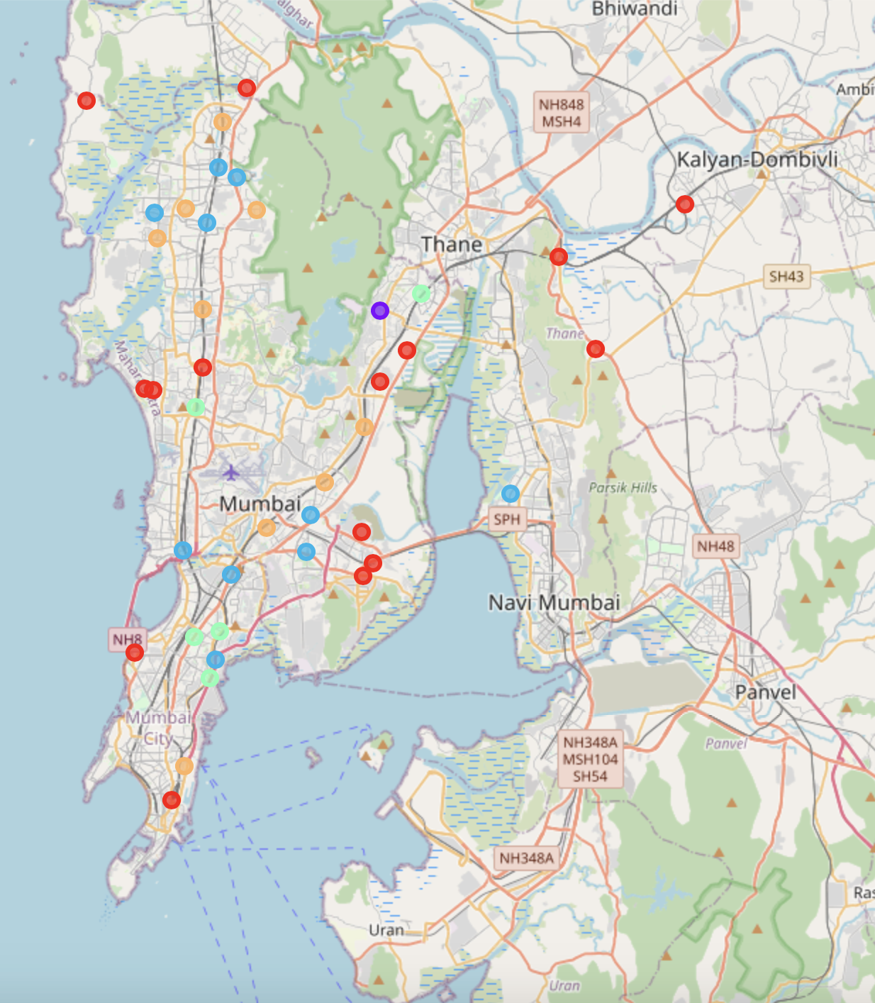
Results
5 clusters based on density
Sonapur, Bhandup has the most concentration for the number of snack places.
Cluster 1 has the lowest infiltration of snack shops
Cluster 1 will be an optimum destination to open a snack shop

Slide 7
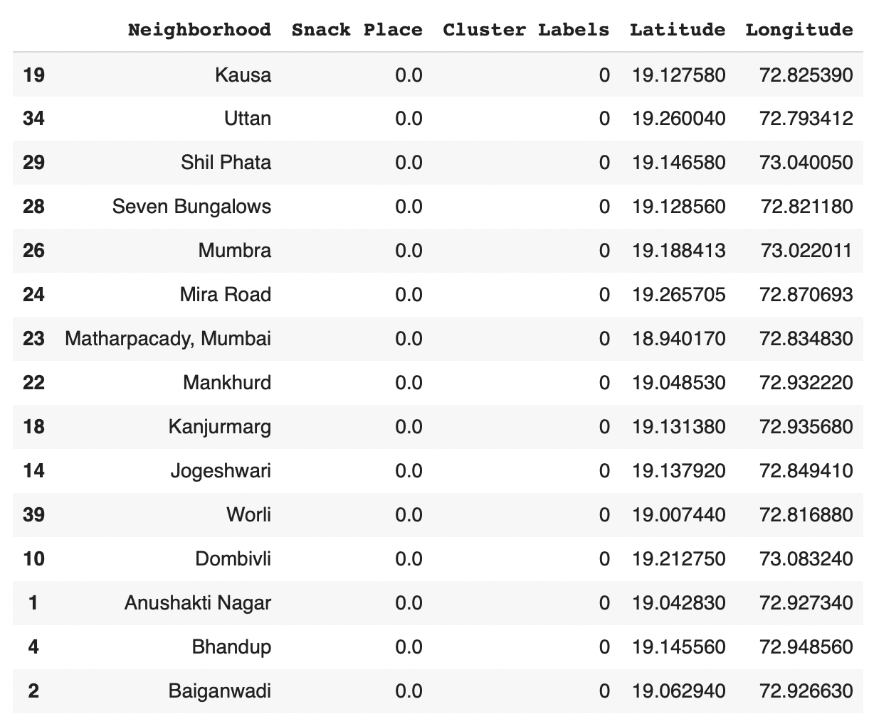
Appendix for cluster 1

Slide 8
conclusion
Hence, we have performed analysis on the city of Mumbai, India with the aim to find the optimum place to open a snack shop.
We have been successful in doing the same and the results are presented in this presentation.
The neighbourhoods in cluster 1 are the most preferred locations to open a new snacking place. Neighbourhoods in cluster 1 are presented in the appendix.

Slide 9
Thank you

